Slide 1

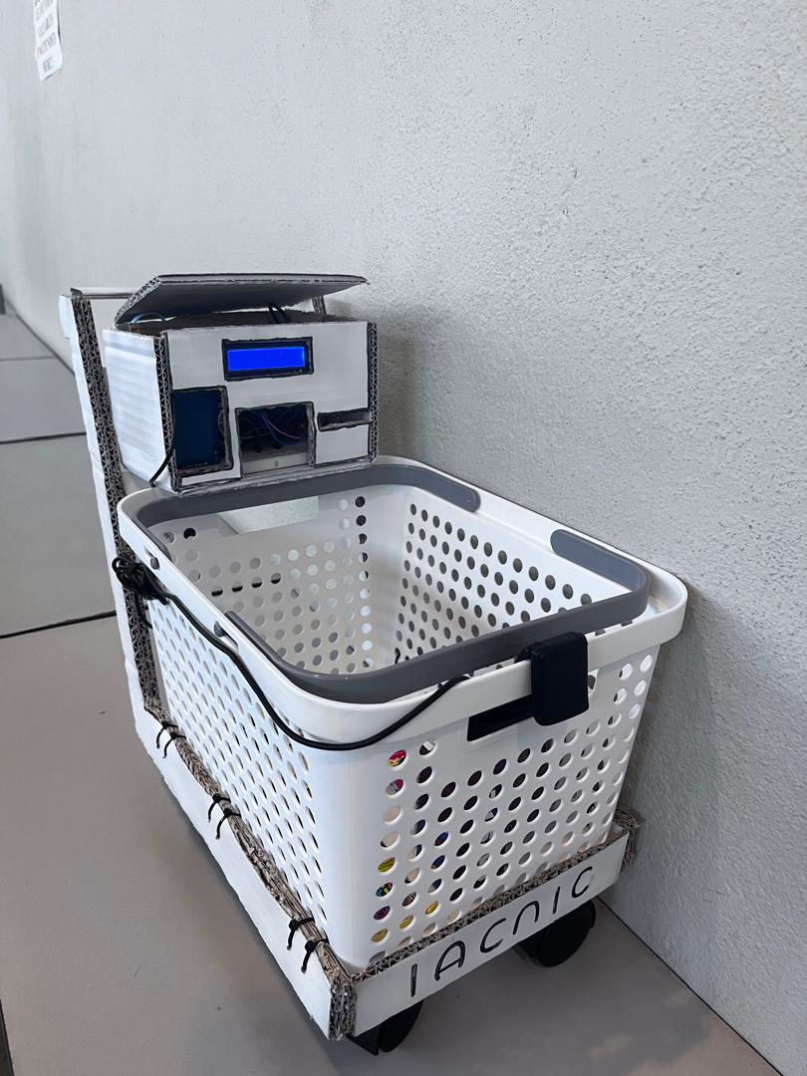
SMART CITIES: SMART SHOPPING

Slide 2
SMART CITIES: SMART SHOPPING
TEAM MEMBERS
NAME | STUDENT ID
FOO KAR YENG | 2300422
LIEW REN YI | 2300434
TAN YI FEI | 2200842
WONG PEI KEI | 2207466

Slide 3
Project Problem Statements
Inefficient Shopping Experience
Manual Payment Processes
Time-consuming
Requiring manual item scanning, price calculation, and queueing for payment.
Lead to customer frustration and long wait times.
Payment systems in stores rely heavily on manual user intervention.
Slowing down the shopping process.
Increasing transaction time.
Lack of Real-time Inventory Management
High Dependency on Manual Intervention
In conventional stores, updating inventory after purchase or item removal is often delayed
Inaccuracies and stock discrepancies.
Conventional shopping systems rely heavily on cashiers or self-checkout systems.
Lead to bottlenecks and errors in product listing or pricing.

Slide 4
Project Objectives
1
2
Automate Product Scanning and Listing
Provide Real-time Notifications
3
4
Implement Real-time Item Removal
Reduce Manual Processes in Checkout
5
6
Integrate Payment System
Accurate Real-time Price Updates

Slide 5



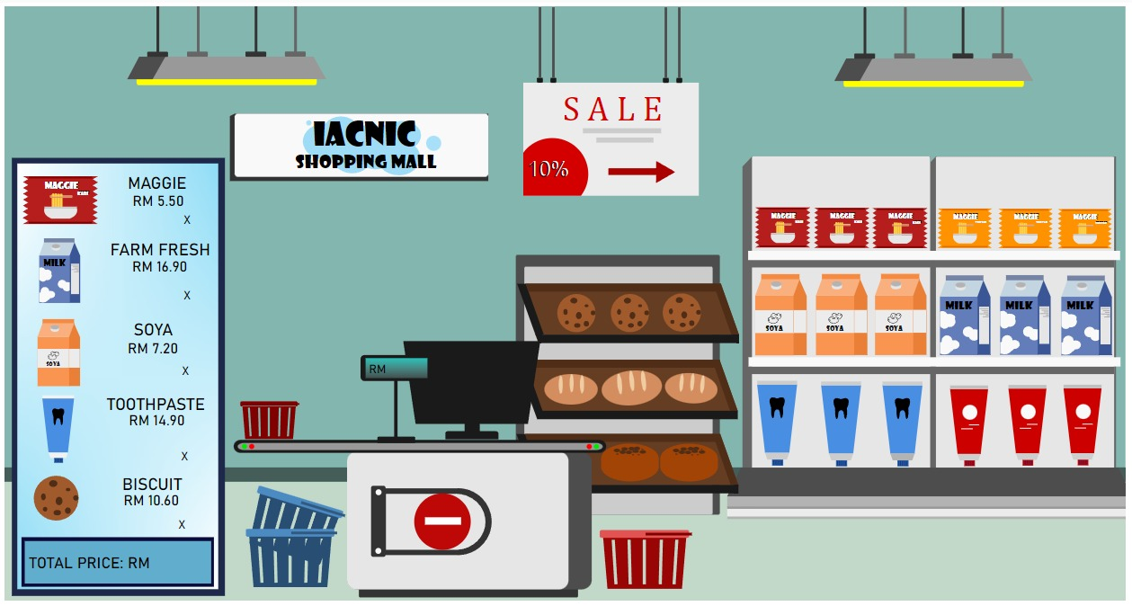



System Design

Slide 6

Unique Features
Shopping Cart
Self-designed shopping cart.
Portable.
Self-service scanning function.
Display the product price on the spot (LCD Display).
Save time when making payment.
1

Slide 7
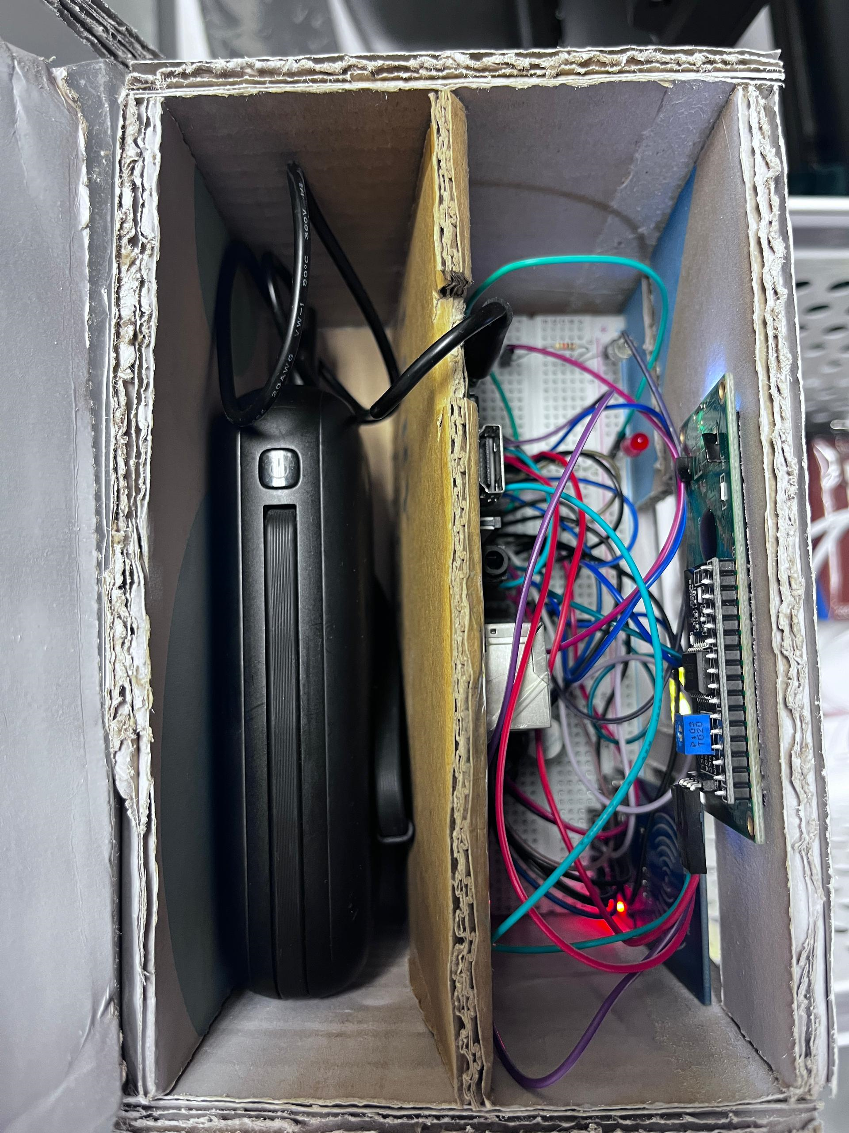

Hardware
Connect to Putty to control Raspberry Pi remotely.
Remove switch to remove unwanted product right away (white LED indicator).
Payment switch to make payment (red LED indicator).
2

Slide 8



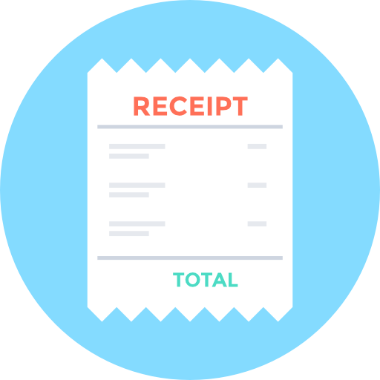
Open MQTT
Payment
Secure Sign Confirmation
List the details of purchased products, removed products and total price.
Click “ Payment “ button to proceed to payment page.
Bank will send a transaction confirmation notification to Telegram.
Able to view the total amount paid.
Snap photo of purchased product as a record.
After payment done, a receipt will send through Telegram.
View Transaction History
Snap Photo Function
Receipt

Slide 9
THANK YOU !

